Slide 1

HTML and CSS
Course Overview
SoftUni Team
Technical Trainers
Software University
http://softuni.bg

Slide 2
Table of Content
Introduction
Training and Team
Course Objectives
Course Organization

Slide 3
Have a Question?
sli.do
#front-end

Slide 4












SoftUni Diamond Partners

Slide 5




SoftUni Organizational Partners

Slide 6
Front-End Development: Module Goals
3 months intensive front-end
2 times weekly, lots of live coding and exercises
Part I - HTML and CSS
HTML, Semantic Tags, CSS, Typography, Box Model, Position and Float, Flexbox, Forms, Media Queries, Practical exam
Part II - CSS Advanced
File Organization, Version Control, CSS Variables, Transitions and Animations, Grid, SASS, Exam Project - Build a Website

Slide 7
Front-End Development Module - Timeline
14-May-2019
9-July-2019
15-August-2019
HTML and CSS
Lessons + exercises + exam
8 weeks * 2 times / week
6 credits
Start: 14-May-2019
Final exam: 7-July-2019
CSS Advanced
Lessons + exercises + exam
6 weeks * 2 times / week
6 credits
Start: 9-July-2019
Final Exam: 11-August-2019
Front-End Development Retake Exams
HTML and CSS -
13-August-2019
CSS Advanced -
15-August-2019

Slide 8

HTML and CSS
Course Objectives & Program

Slide 9

HTML and CSS - Course Topics
Introduction to HTML and CSS
HTML Structure
3. CSS & Typography
4. CSS Box Model
5. Position & Float
6. Flexbox

Slide 10
HTML and CSS - Course Topics
7. Working with Forms
8. Media Queries
9. Design to Code – Demo Project
10. Exam Preparation

Slide 11

Trainers and Team

Slide 12

Konstantin Dankov
17 years experience with HTML and CSS
Started working as a Front-End developer
when he is 18 years old - at that time Firefox
did not exist and Internet Explorer 6 was a
modern browser

Slide 13
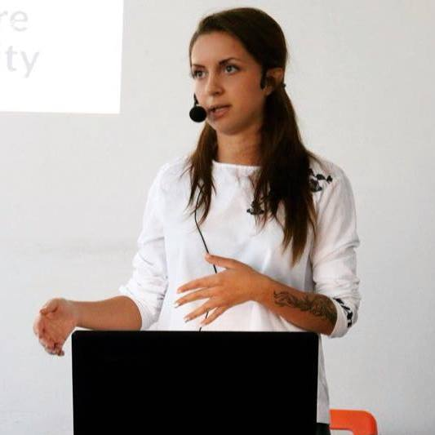
Antonia Atanasova
Experience in JS, HTML5, CSS3, Bootstrap, C#, CMS Systems
Program Lead JS & Technical Trainer in SoftUni
Web Development Freelancer
Contacts:
http://antoniaat.com
a.atanasova@softuni.bg

Slide 14

Course Objectives
Course Details and Schedule

Slide 15
Why HTML & CSS?
HTML & CSS - standard for Web User Interface (UI)
Web-based applications are very popular
Runs on any device with a web browser
HTML5 is currently the #1 job trend based on the fastest growing keywords found in online job postings
HTML5 takes bigger chunk of the mobile application market
Every IT professional should know HTML & CSS

Slide 16

Exam
Structure: 3 problems for 4 hours
Slice a screenshot to HTML + CSS
Make a responsive page
Create a simple landing page from screenshot (header + menu + sidebar + form elements + footer)

Slide 17
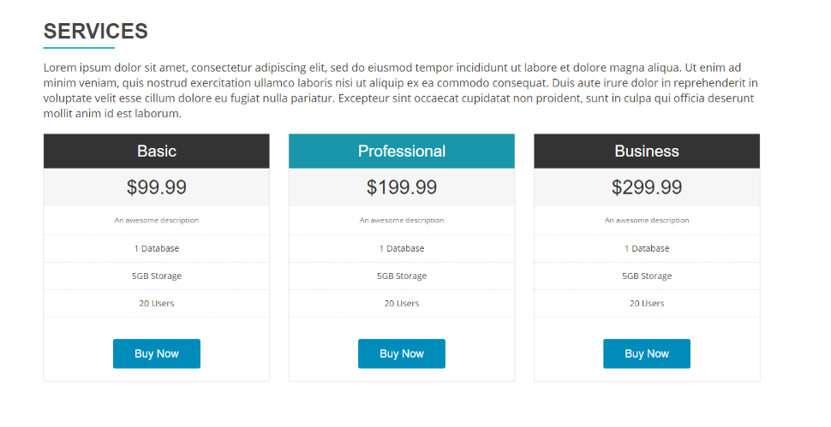
Exam: First Problem Demo
Slice a screenshot to HTML + CSS

Slide 18
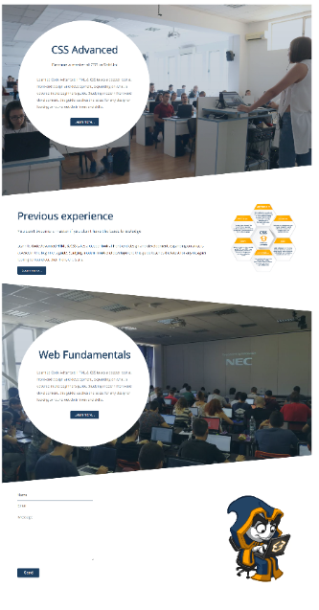

Exam: Second Problem Demo
Make a website responsive

Slide 19

Exam: Third Problem Demo
Create a simple web page from screenshot

Slide 20

Course Organization
Resources

Slide 21
Evaluation Criteria
Mandatory
Final exam - 95%
Exercises & homework - 5%
Bonuses:
Presence in class – 5% bonus (onsite students only)

Slide 22
Homework Assignments
Doing your homework is very important!
HTML and CSS can only be learned through a lot of practice!
You should write code every day!
Each lesson is followed by a few exercises
Try to solve them in class
The rest are your homework
Homework assignments are due in 7 days after each lesson
Submission are accepted through: judge.softuni.bg

Slide 23
Website, Forum and FB Group
Official website:
Official discussion forum:
Official Facebook group:
https://softuni.bg/trainings/2375/html-and-css-may-2019
https://softuni.bg/forum/categories/671/Front-End-Development
https://www.facebook.com/groups/FrontEndMay2019/

Slide 24
Code Editors
You may try many HTML authoring tools
Recommended:
Visual Studio Code
Other notable editors:
WebStorm
Sublime Text / Atom / Brackets

Slide 25
Learn to Search in Internet & Find Solutions
The course assignments require to search in Internet
This is an important part of the learning process
Some exercises intentionally have no hints
Learn to find solutions!
Software development includes everyday searching and learning
No excuses, just learn to study!
Developers learn new technologies, tools, languages every day!

Slide 26
https://softuni.bg/trainings/2356/html-and-css-may-2019

Slide 27




Trainings @ Software University (SoftUni)
Software University - High-Quality Education and Employment Opportunities
softuni.bg
Software University Foundation
http://softuni.foundation/
Software University @ Facebook
facebook.com/SoftwareUniversity
Software University Forums
forum.softuni.bg

Slide 28

License
This course (slides, examples, demos, videos, homework, etc.) is licensed under the "Creative Commons Attribution-NonCommercial-ShareAlike 4.0 International" license

